Slide 1
InstaSMart App
Guided by : Muskan

Slide 2
User Login
User can do login with his username and password.
After login he redirect to home page.
User can see different products and can add products to cartlist and can checkout the products.
User can’t perform the crud operation.
After successful transaction user can do logout .

Slide 3
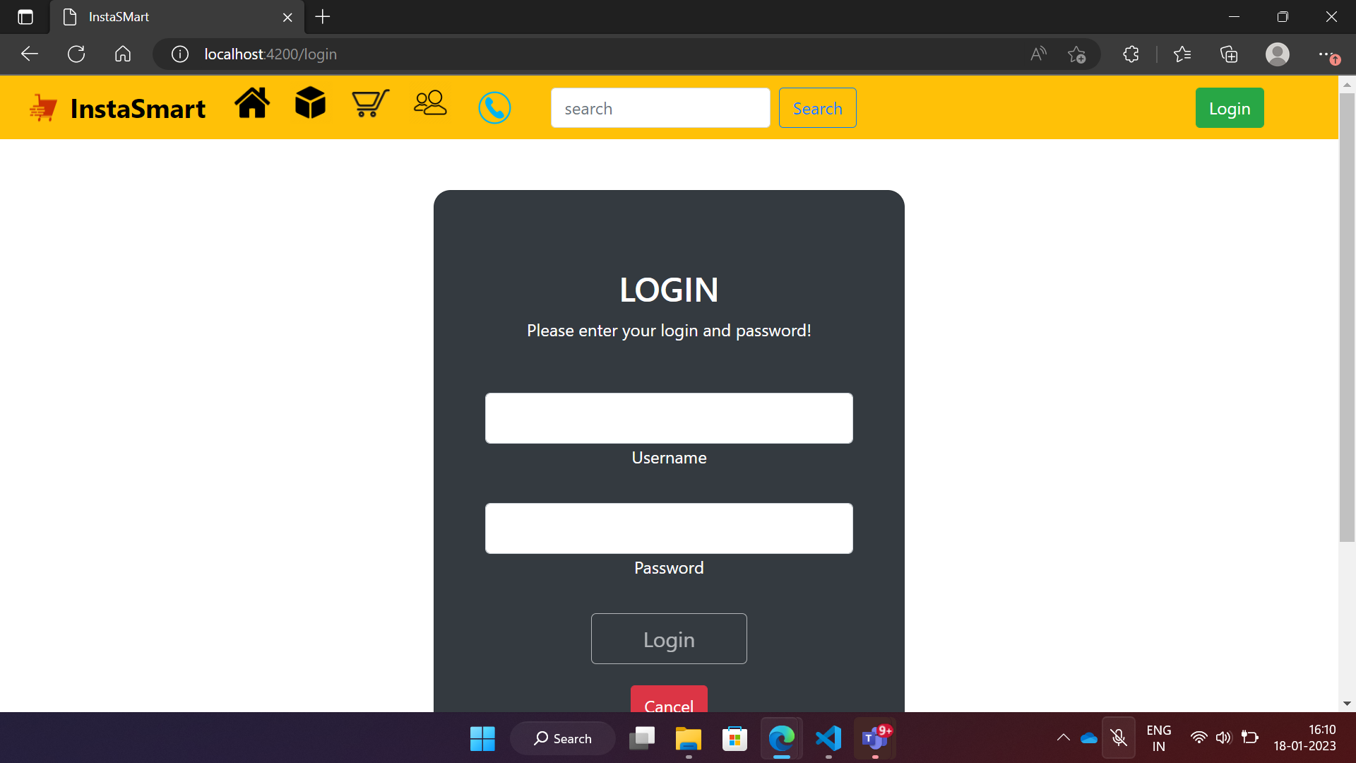
Login page

Slide 4
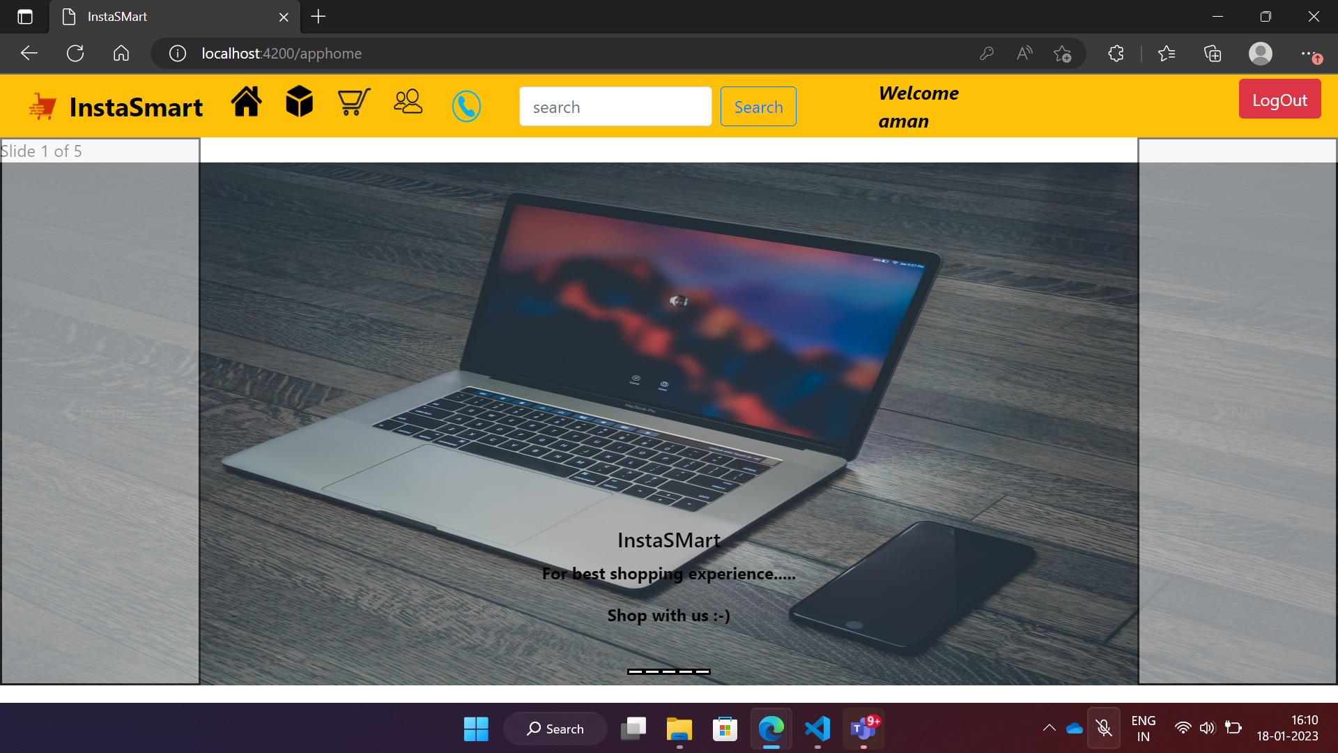

Slide 5
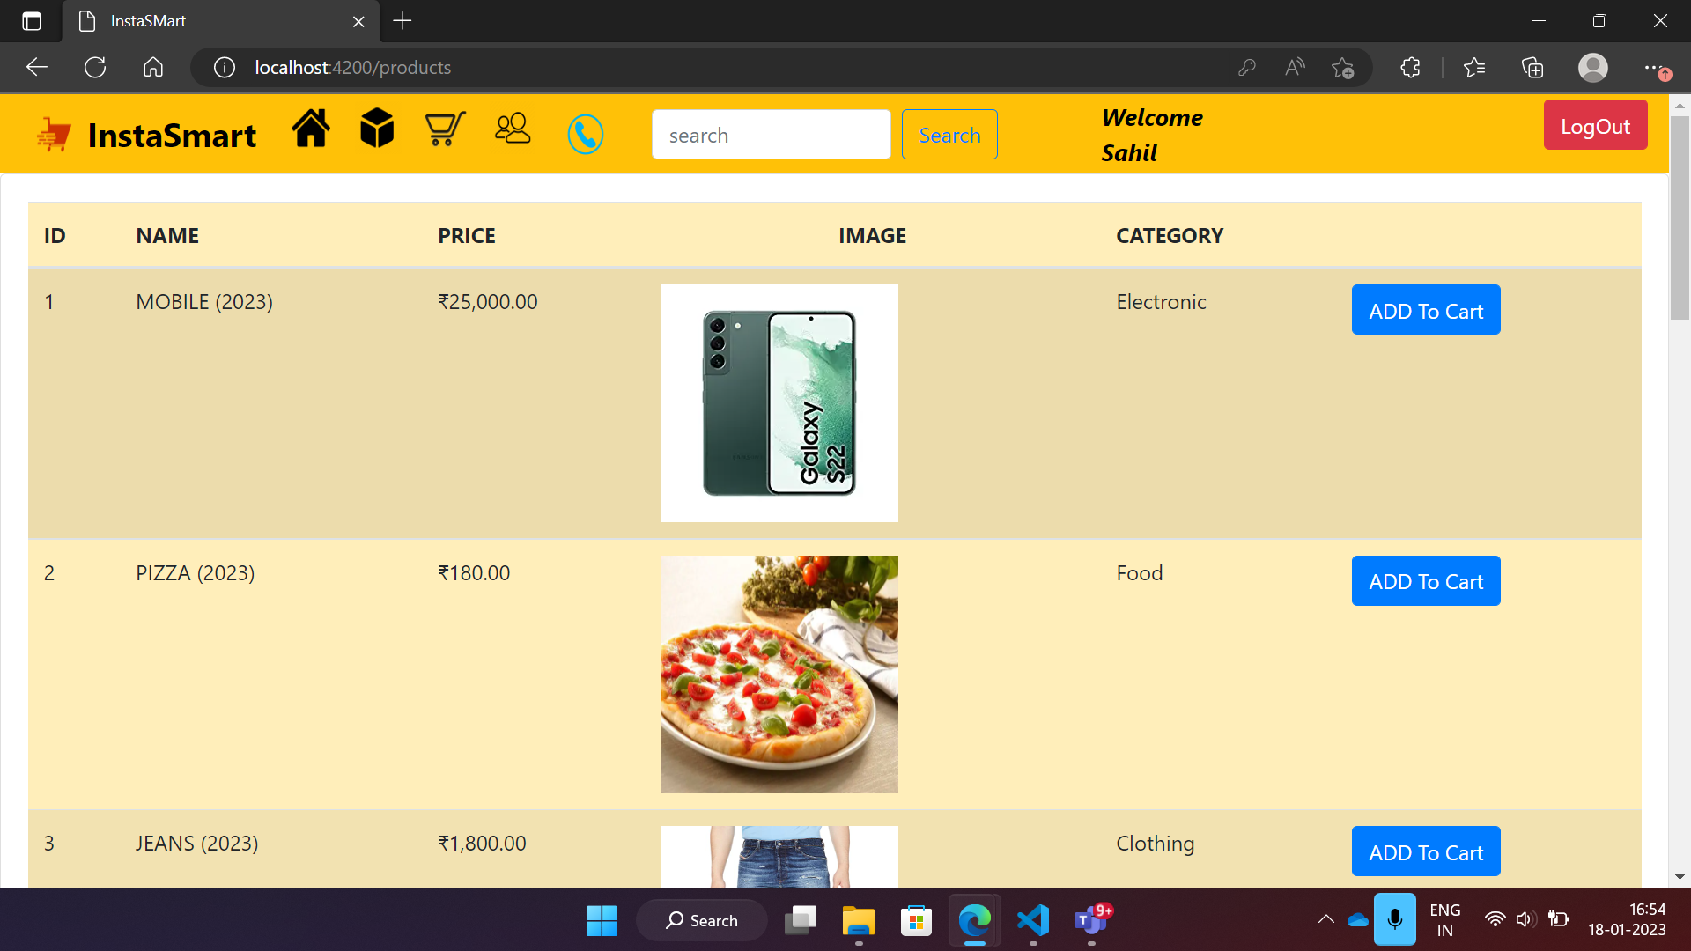

Slide 6
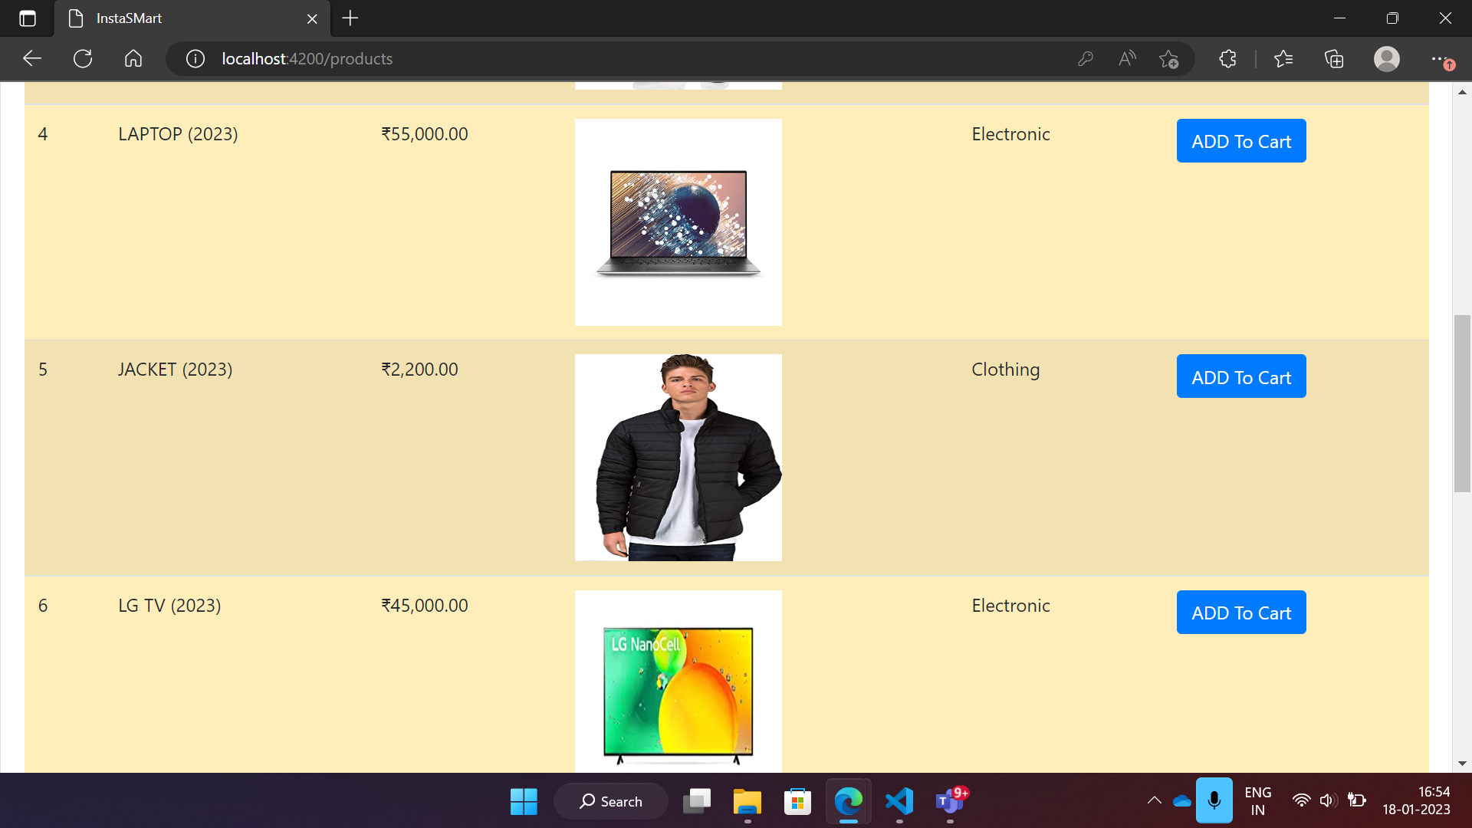

Slide 7
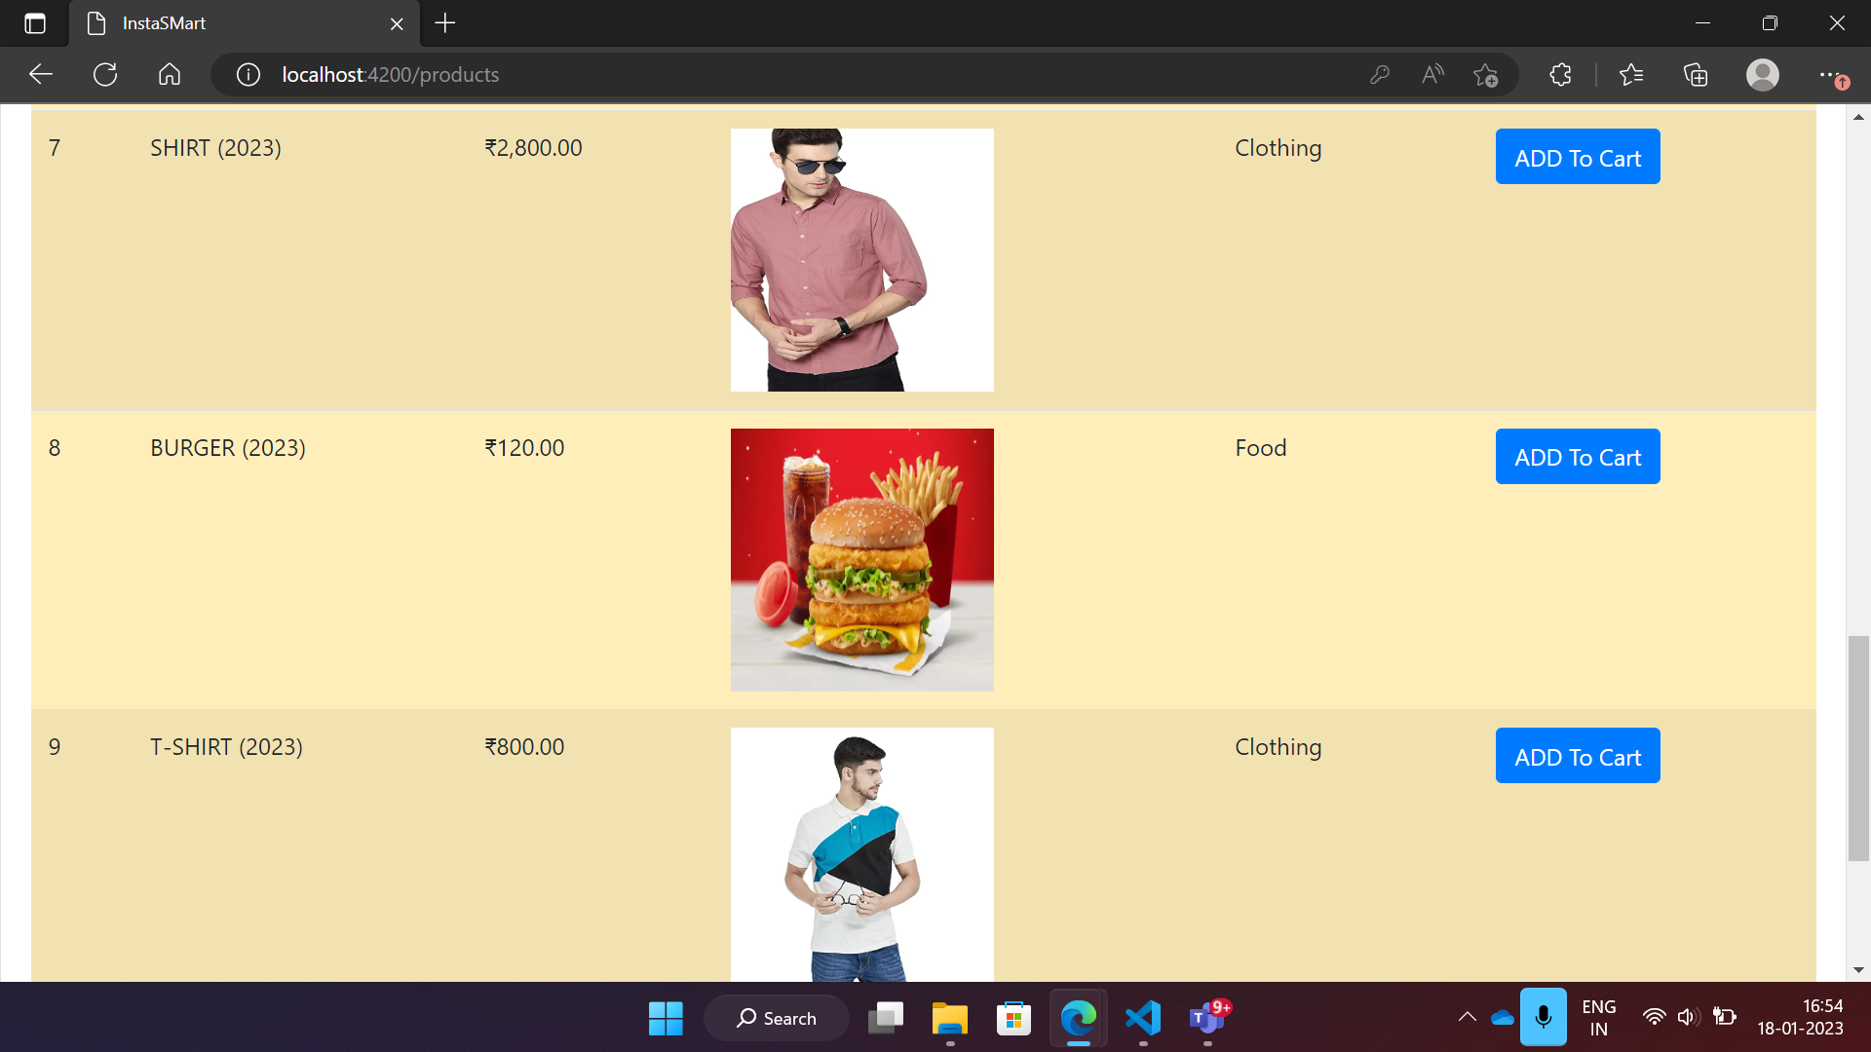

Slide 8
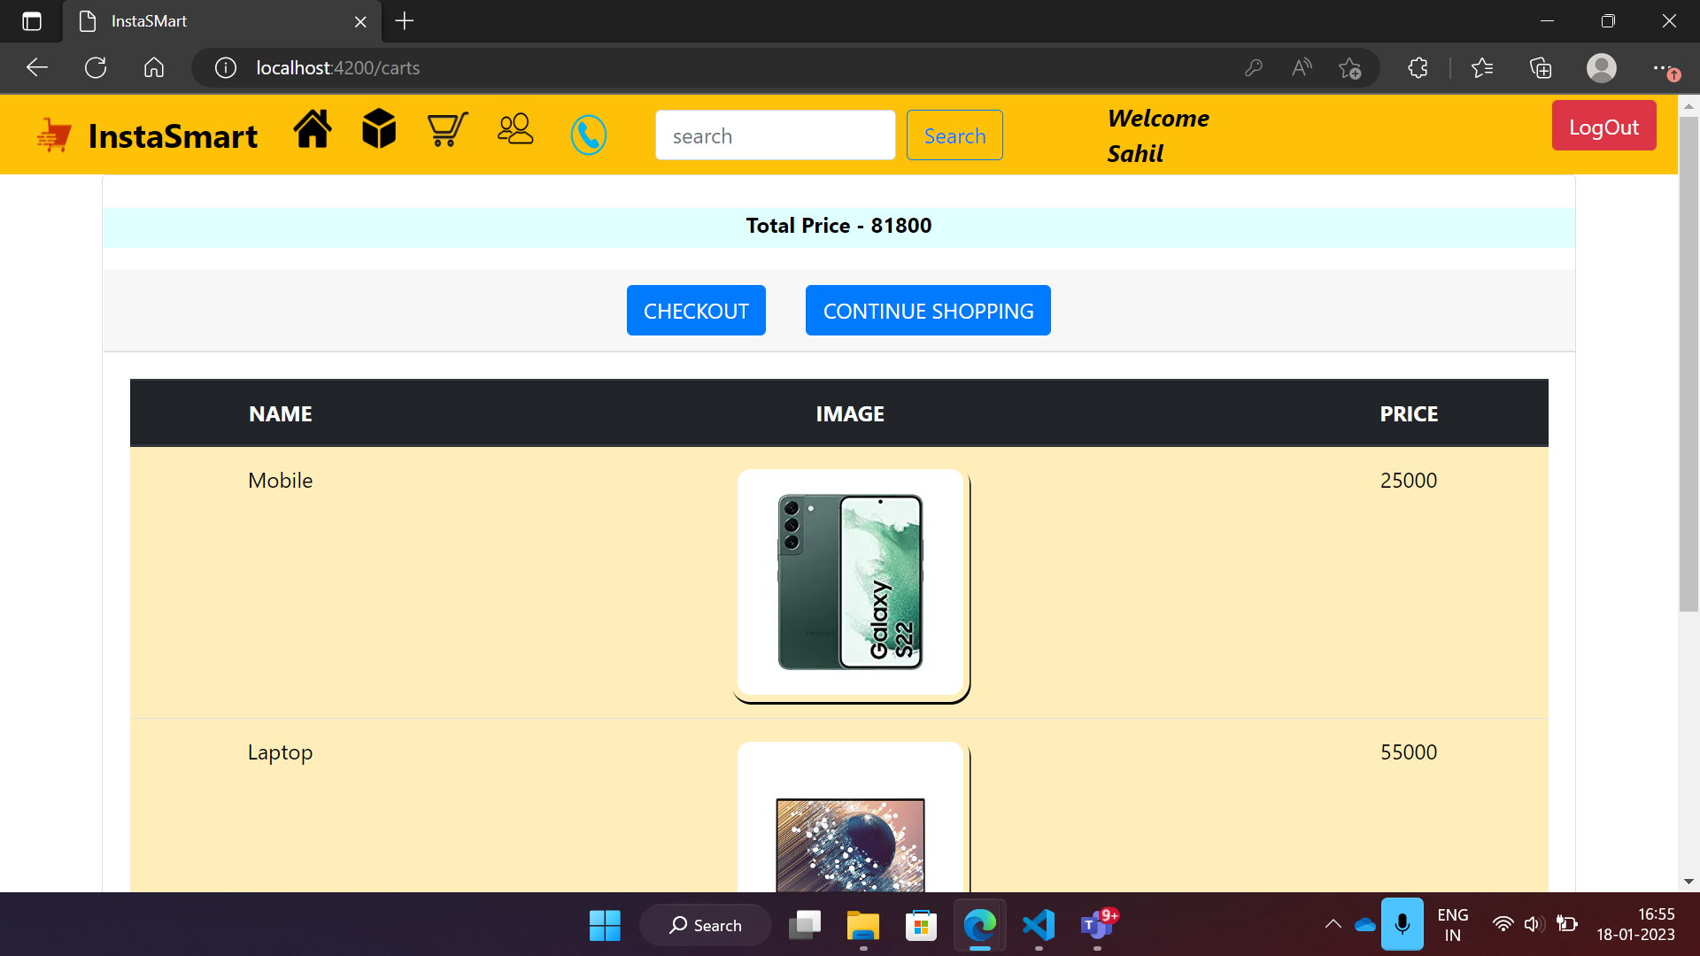

Slide 9
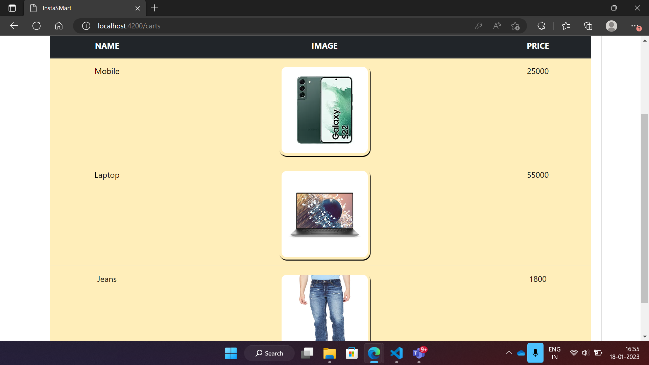

Slide 10
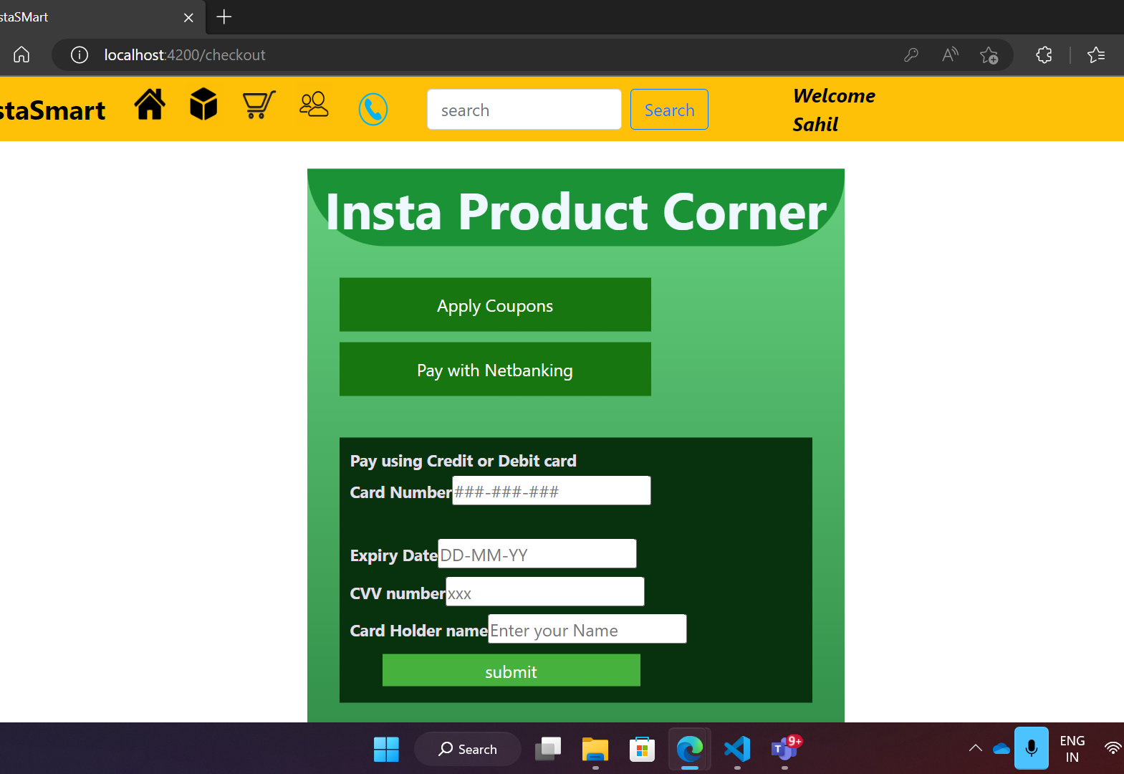
Checkout

Slide 11
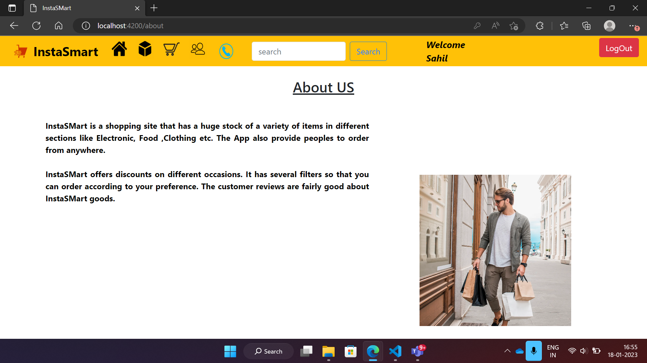
About Us

Slide 12
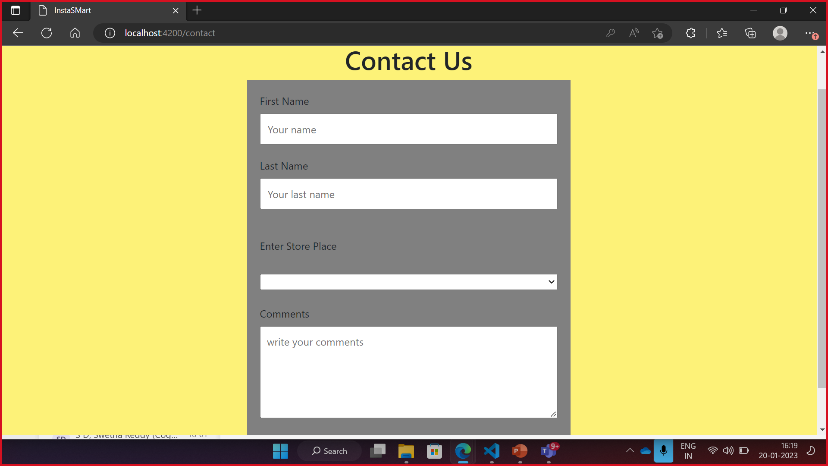
Contact Us

Slide 13
ADMIN
I have added default admin credentials in db.
If admin logins the App then he redirect to Producs page.
He can perform crud operation on products.
Like adding new products , editing ,updating and deleting the products in product list.
Admin can also filter the products.
Admin can’t buy the products, if he want to buys then he has to do from user login.

Slide 14
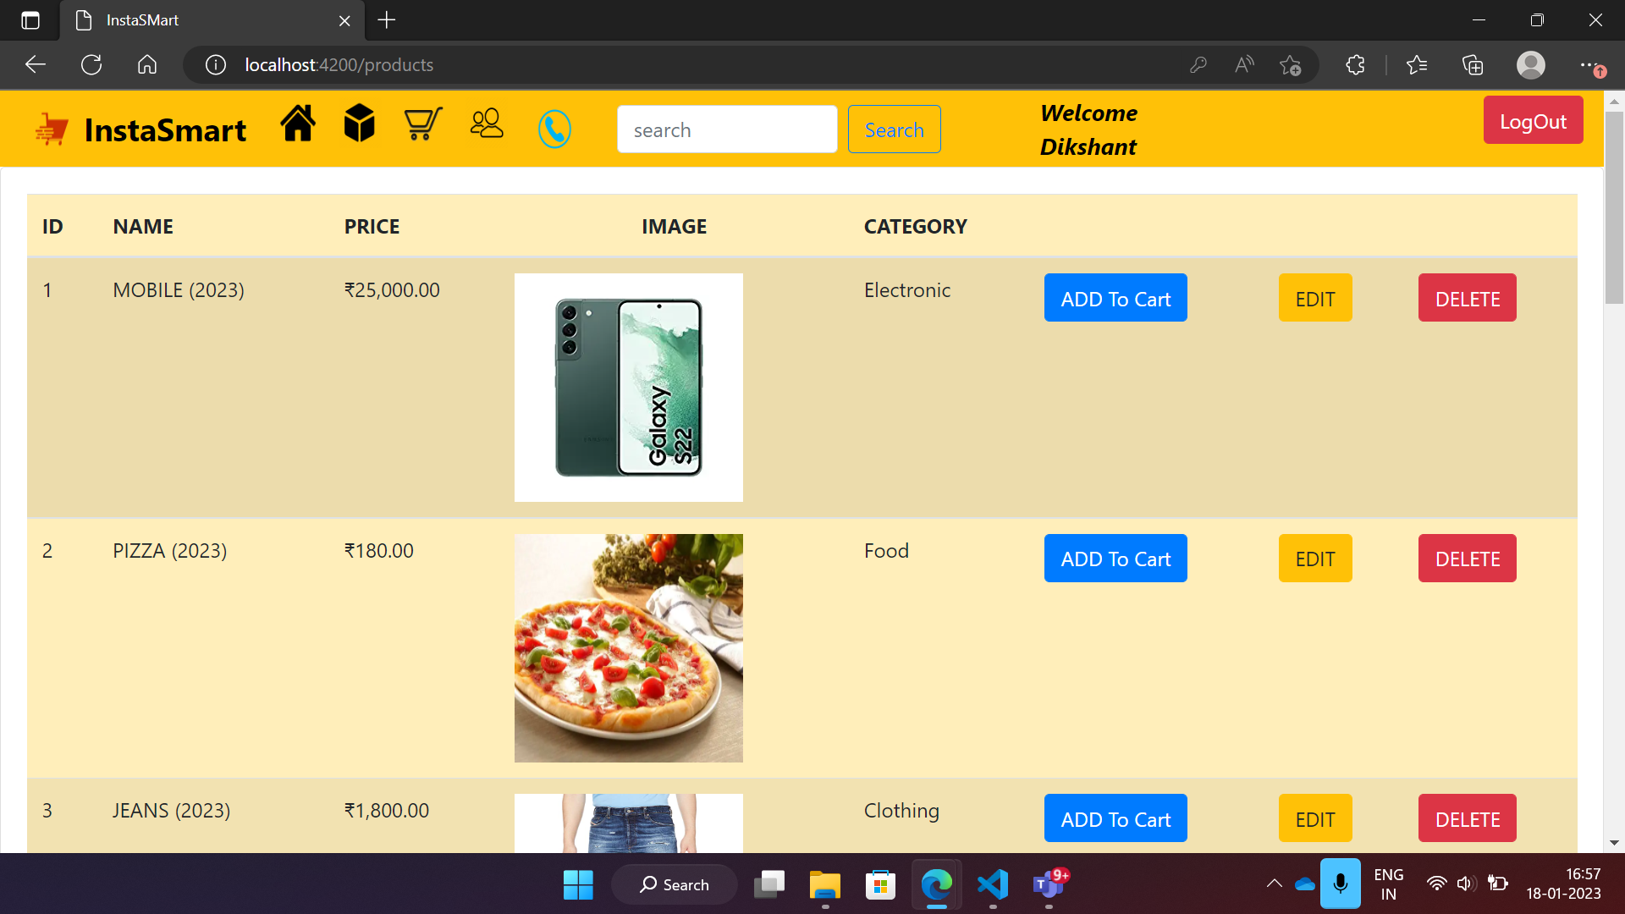

Slide 15
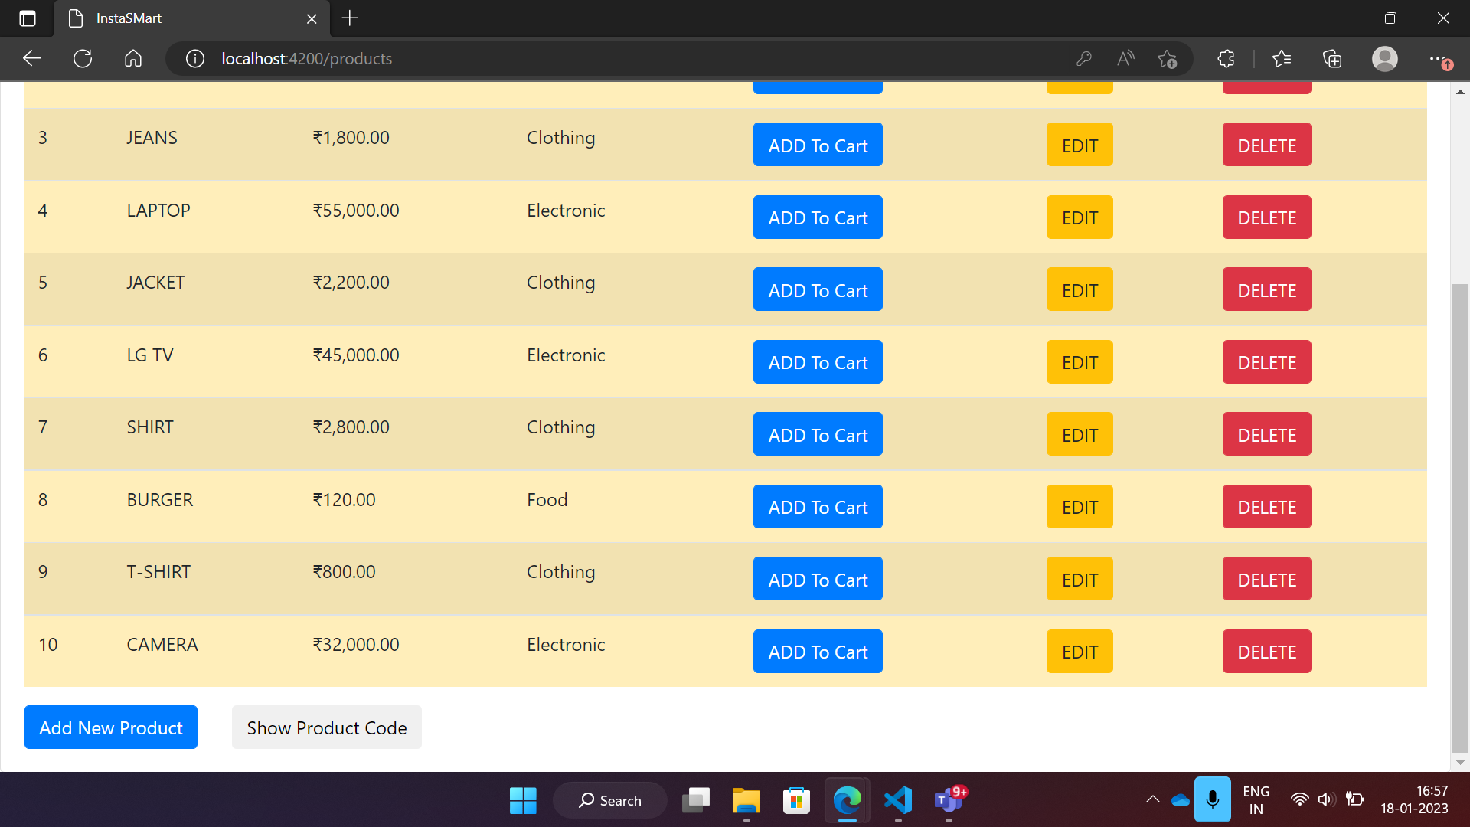

Slide 16
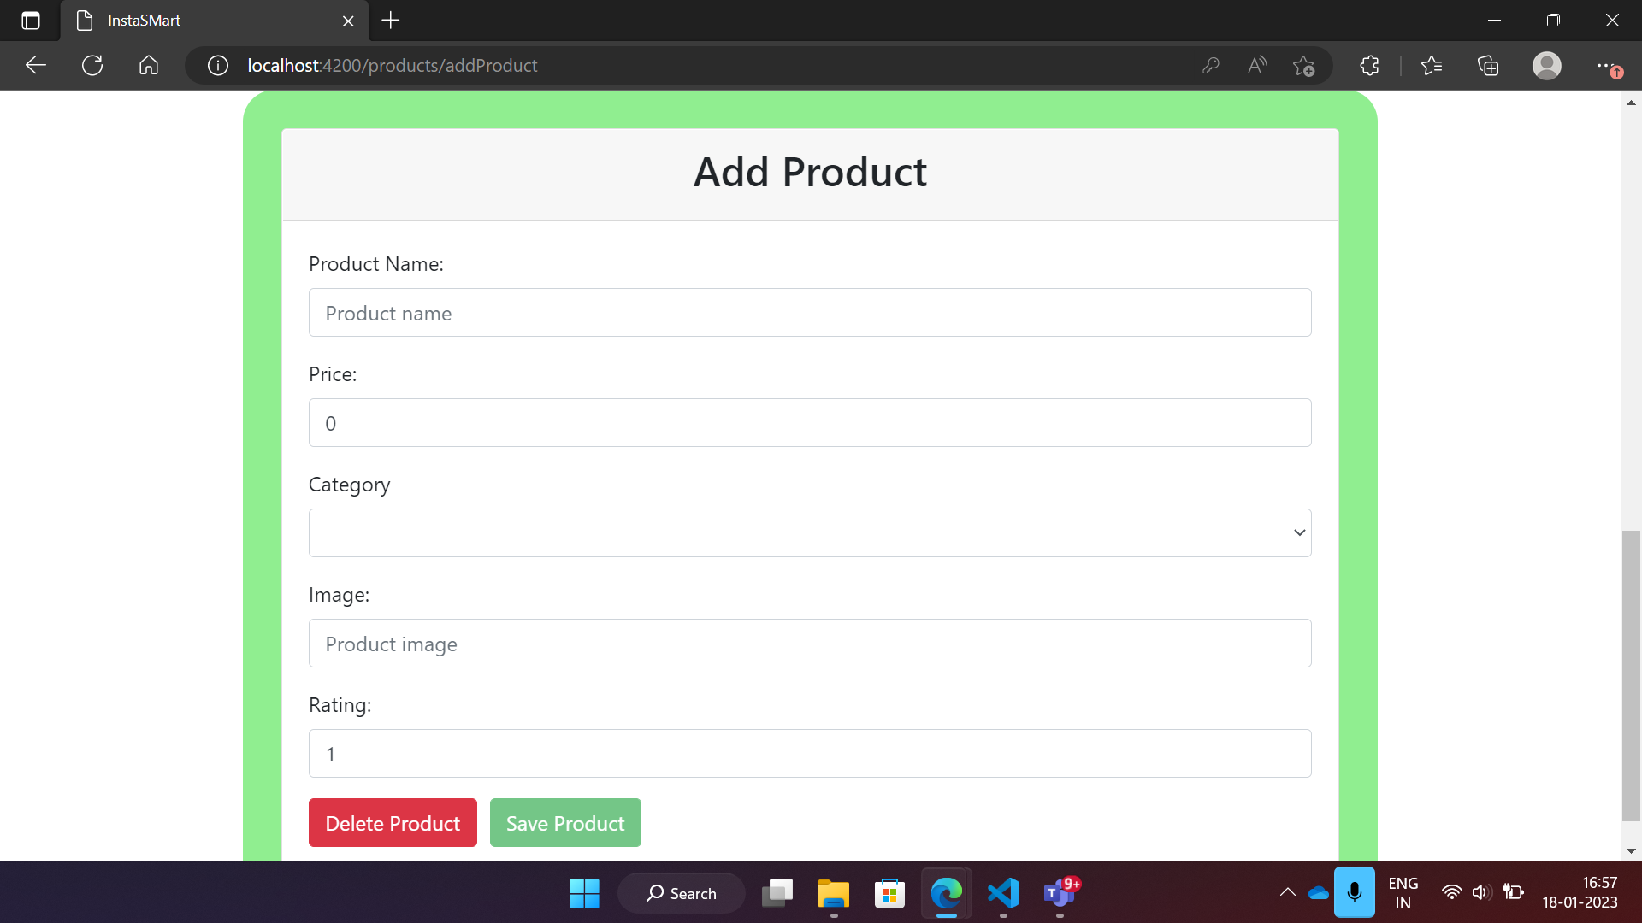

Slide 17
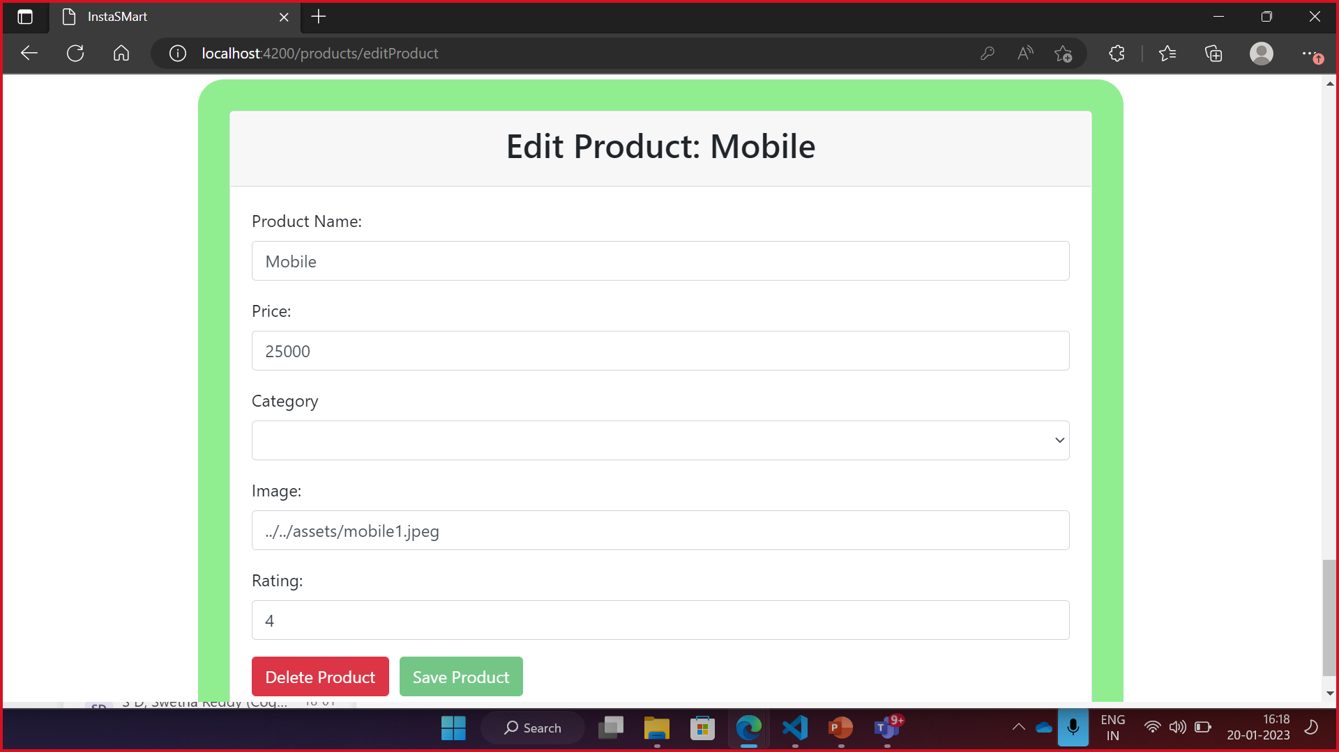

Slide 18

Thank You

